Slide 1
Group members
Names | Registration number
Nibishaka Jean damascene | 219000416
Mugisha Israel | 220002675
Kwibuka Elias | 220009648

Slide 2
CLINIC HEALTH SYSTEM
The project Clinic Health system includes registration of patients, storing their details into the system, and also computerized billing in the pharmacy, and labs. The software has the facility to give a unique id for every patient and stores the details of every patient and the

Slide 3
staff automatically. It includes a search facility to know the current status of each room. User can search availability of a doctor and the details of a patient using the id.
The Clinic Health System can be entered using the email and password. It is accessible by an Administrator . Only they can add data into the database. The data can be retrieved easily. The interface is very user-friendly. The data are well protected for personal use and makes the data processing very fast.

Slide 4
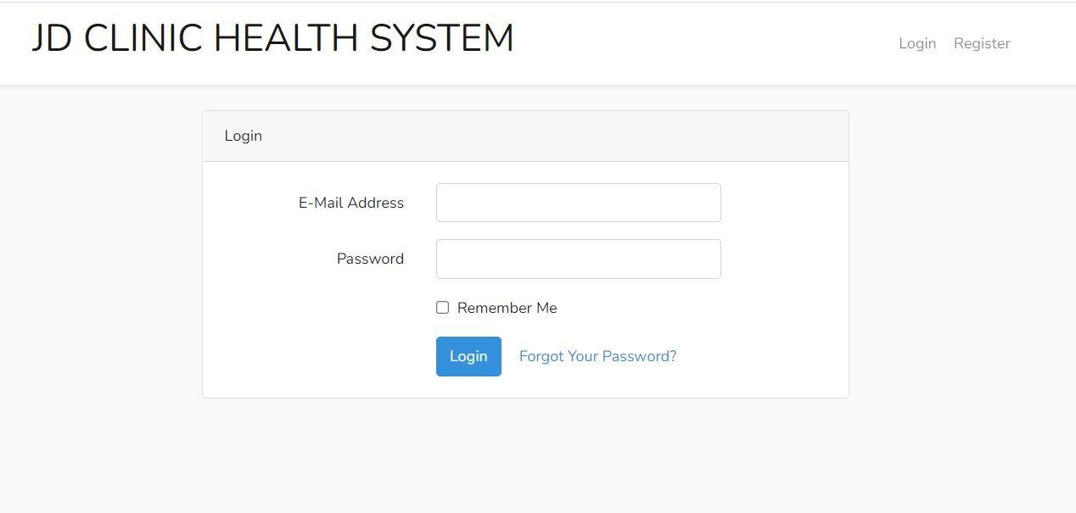
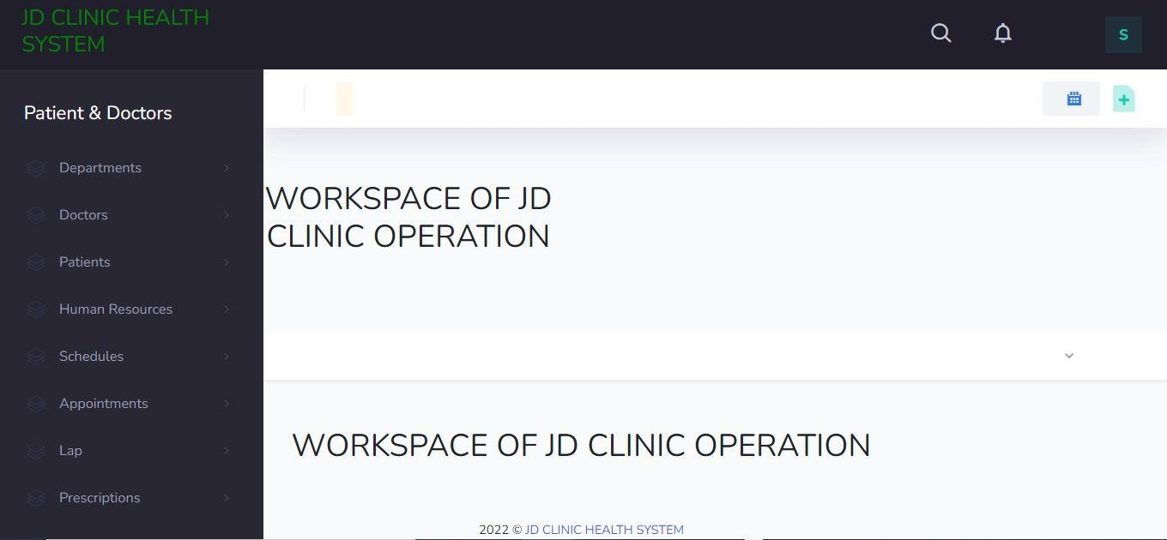
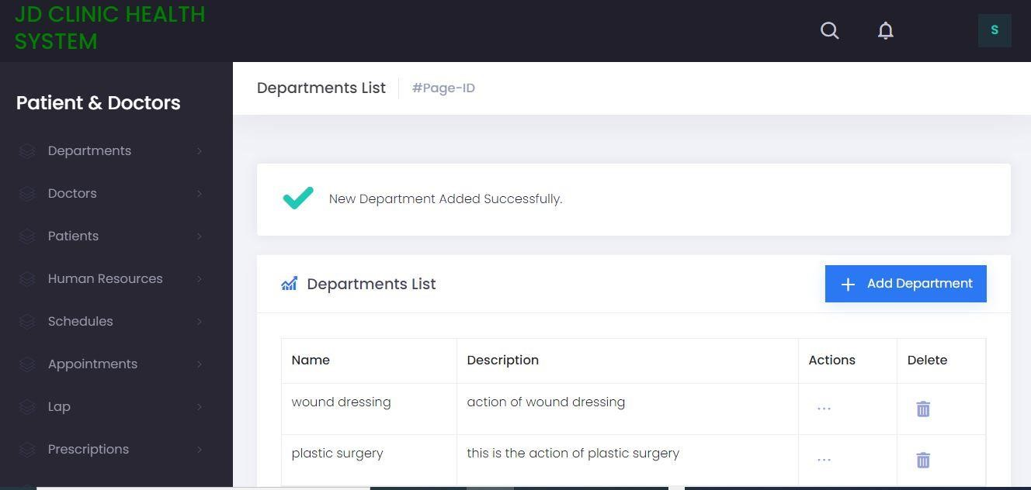
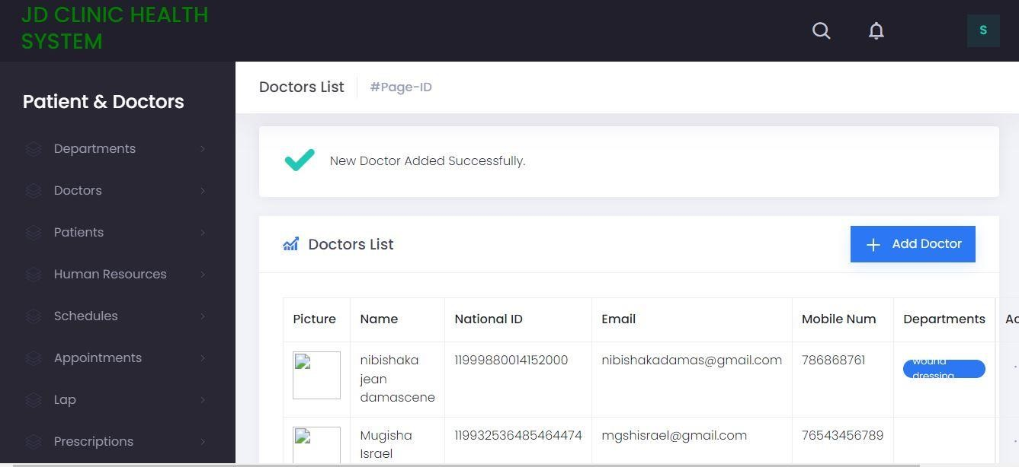

Slide 5
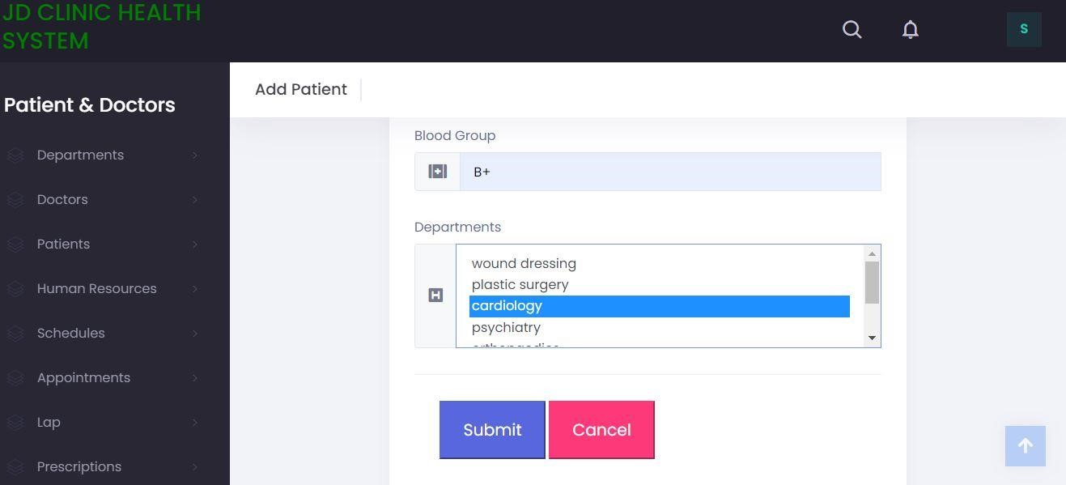
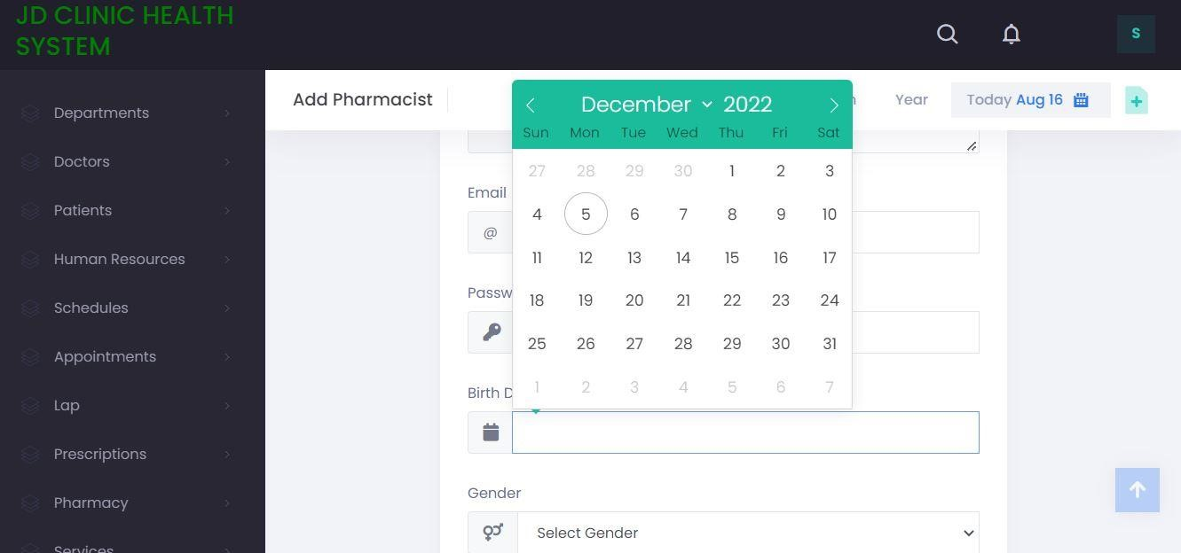
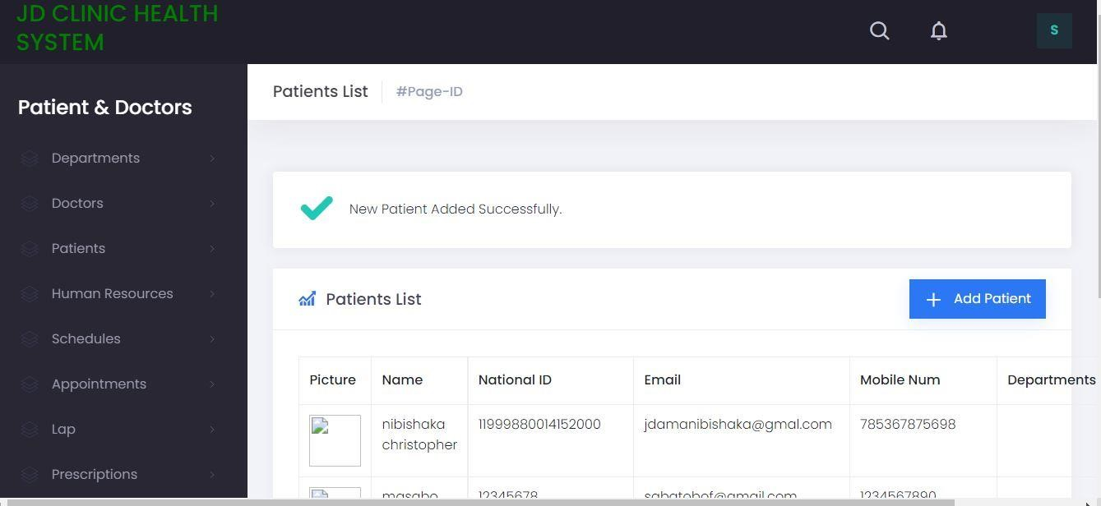

Slide 6
OBJECTIVES OF CILINIC HEALTH
1.Define clinic
2.Recording information about the Patients that come.
3.Generating bills.
4.Recording information related to diagnosis given to Patients.
5.Keeping record of the Immunization provided to children/patients.
6.Keeping information about various diseases and medicines available to cure them.

Slide 7
AS CONCLUSION
Clinic Health System is a software product suite designed to improve the quality and management of clinic management in the areas of clinical process analysis and activity-based costing. Clinic Health System enables you to develop your organization and improve its effectiveness and quality of work. Managing the key processes efficiently is critical to the success of the clinic helps you manage your processes

Slide 8
END

